Slide 1
COVID-19 UPDATE
19 February 2023

Slide 2
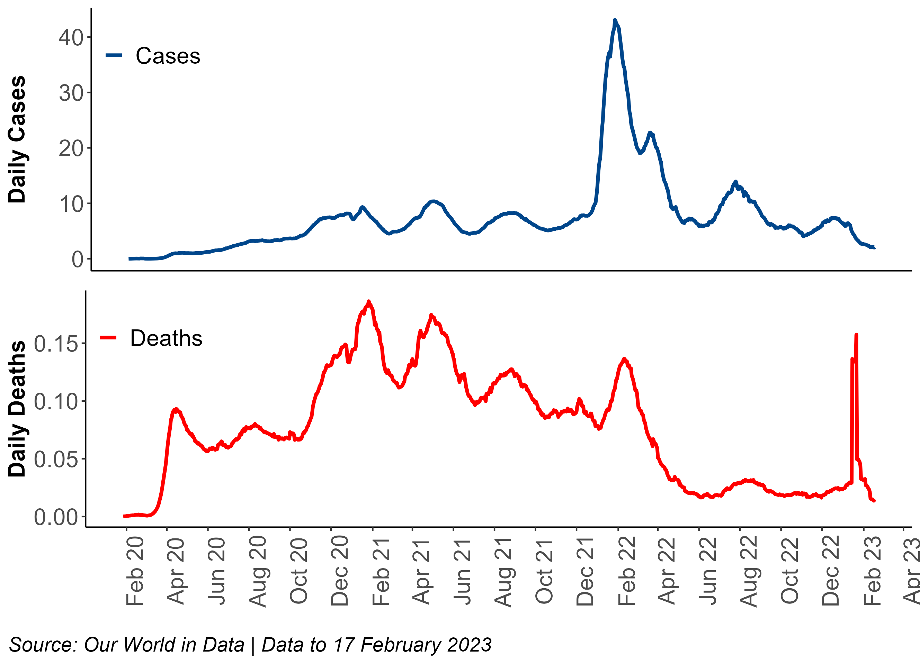
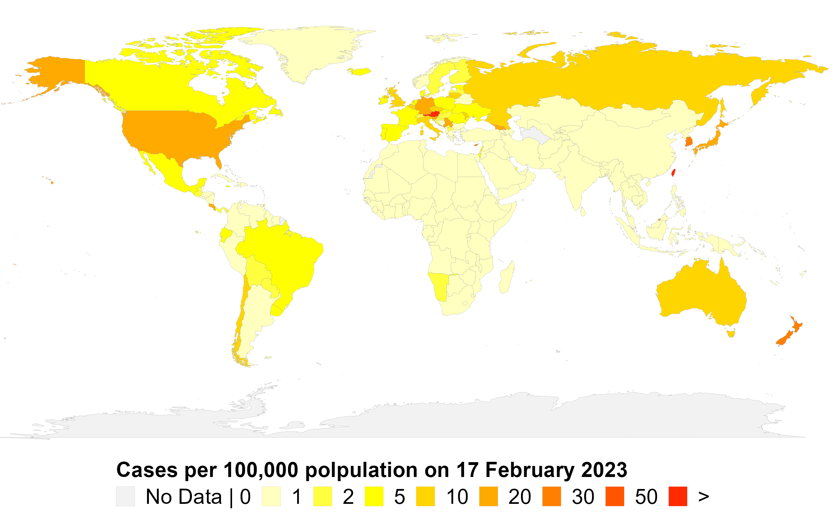
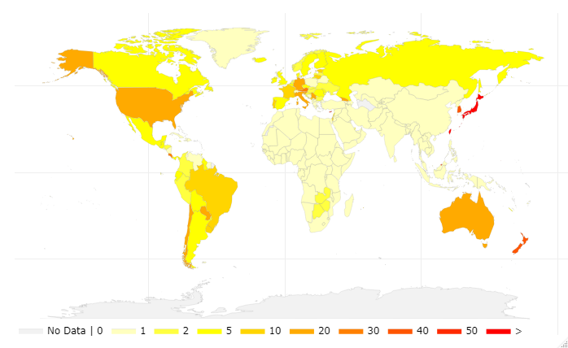
1. Global COVID-19 pandemic at a glance
Time series of reported cases & deaths
7-day rolling average per 100,000 population

Slide 3
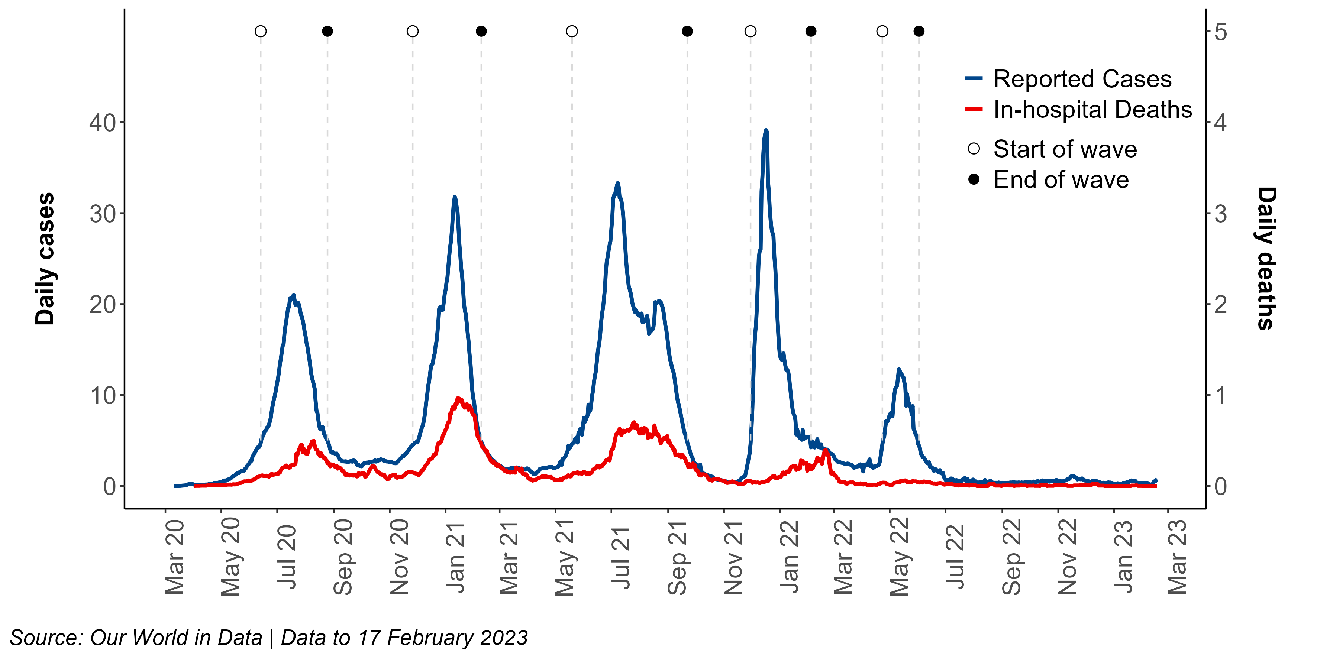
2. COVID-19 in South Africa
Time series of reported cases & deaths
7-day rolling average per 100,000 population
Current
__ __ __
% change
since last
end-of-wave
(236 days)
4,603,349
Cases
102595
Deaths
2.45% ↑ in
Cases
1.33% ↑ in
Deaths

Slide 4
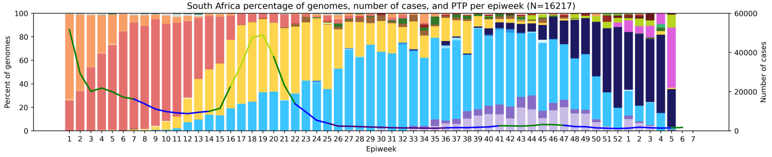
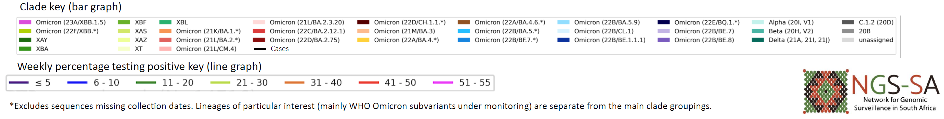
3. Distribution of variants over time
South Africa (2022-2023), n = 16 217*

Slide 5
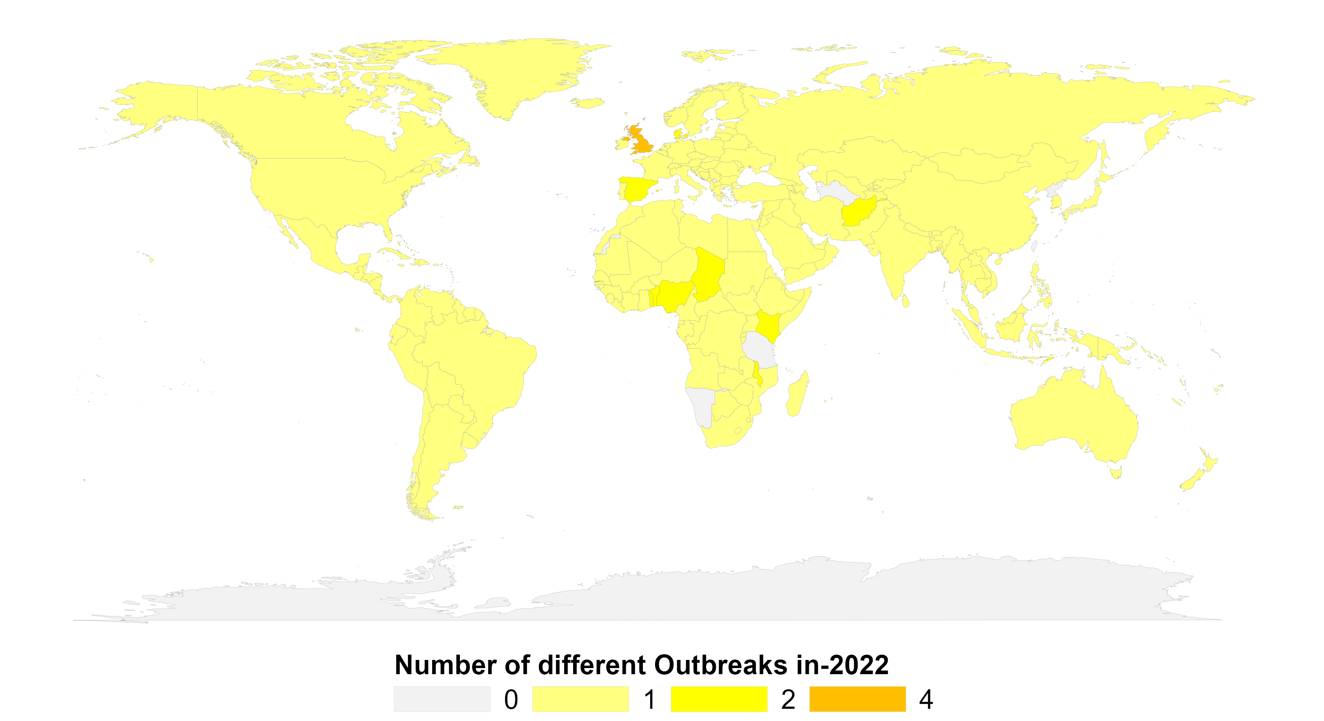
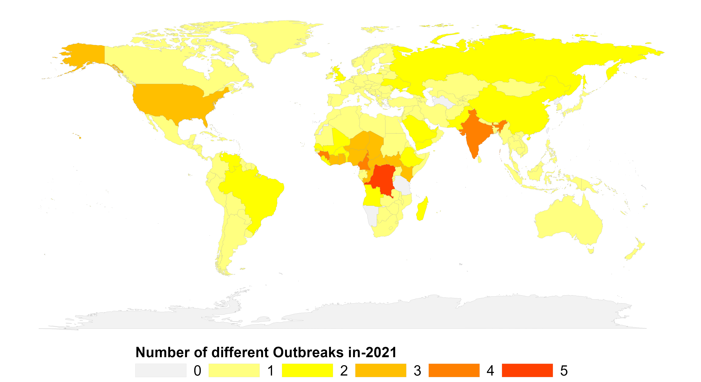
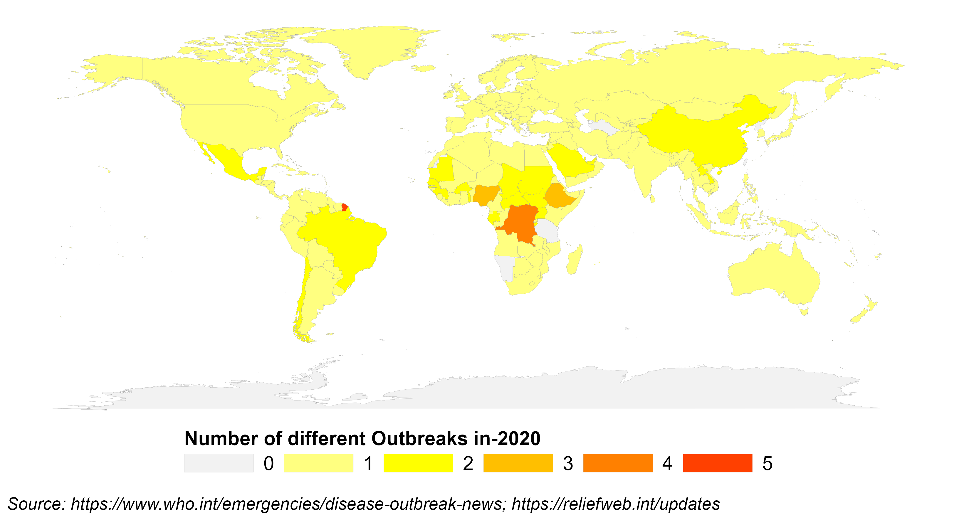
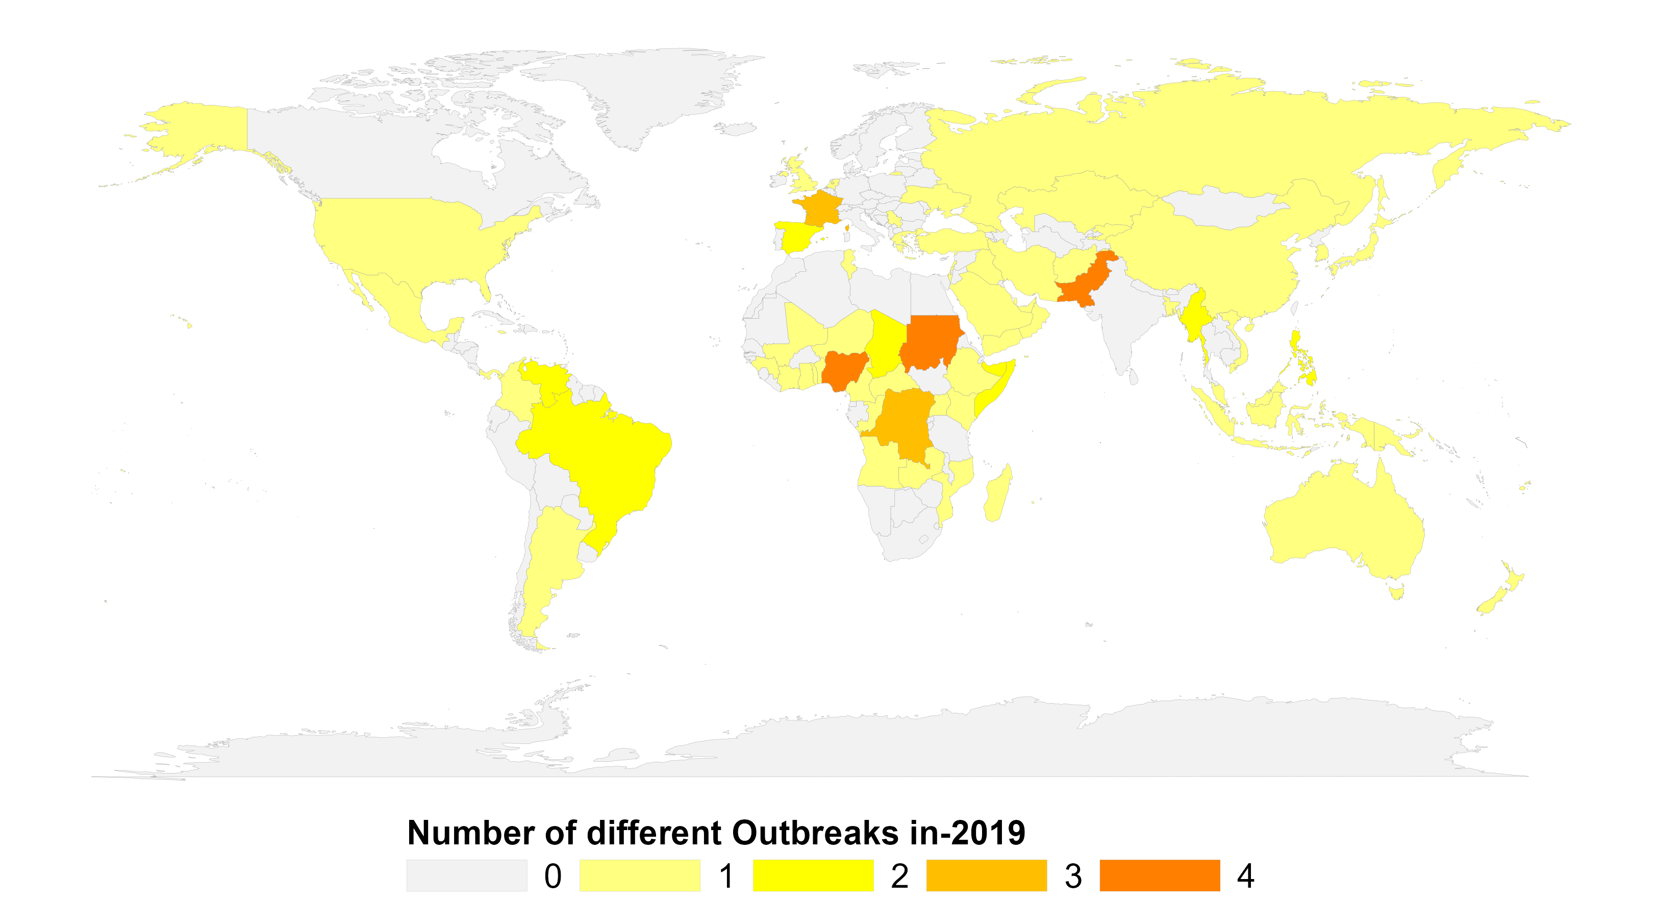
4. Multiple Outbreaks
2022
2021
Disease (countries)
COVID-19 (195)
Intestinal infections due to Shigella (3)
Lassa fever (3)
Measles (1)
Cholera (1)
Disease (countries)
COVID-19 (195)
Acute poliomyelitis (23)
Yellow fever (10)
Influenza virus (5)
Cholera (2)
2020
2019
Disease (countries)
COVID-19 (195)
Yellow fever (9)
Dengue fever (7)
Measles (4)
Middle East respiratory syndrome (3)
Disease (countries)
Measles (42)
Acute poliomyelitis (22)
Dengue fever (6)
Yellow fever (4)
Middle East respiratory syndrome (4)

Slide 6

5. Marburg virus outbreak in Equatorial Guinea
1st outbreak in 1967 (in Marburg and Frankfurt, Germany) – lab workers exposed to blood/tissue products of African green monkeys from Uganda
  31 infections, 7 fatalities
1998–2000 (Durba, DRC) - individuals working in an underground gold mine
  154 cases, 83% case fatality rate
2004–2005 (northern Angola) – nosocomial & community-acquired infection
  252 cases, 90% case fatality rate - Largest and most lethal Marburg outbreak
16 February 2023 (Equatorial Guinea & Cameroon)
  16 cases, 9 deaths
Bats are the reservoir host
No approved postexposure treatments or vaccine
Source: Geisbert TW. Marburg and Ebola hemorrhagic fevers (Filoviruses). Mandell, Douglas, and Bennett's Principles and Practice of Infectious Diseases. 2015:1995.

Slide 7
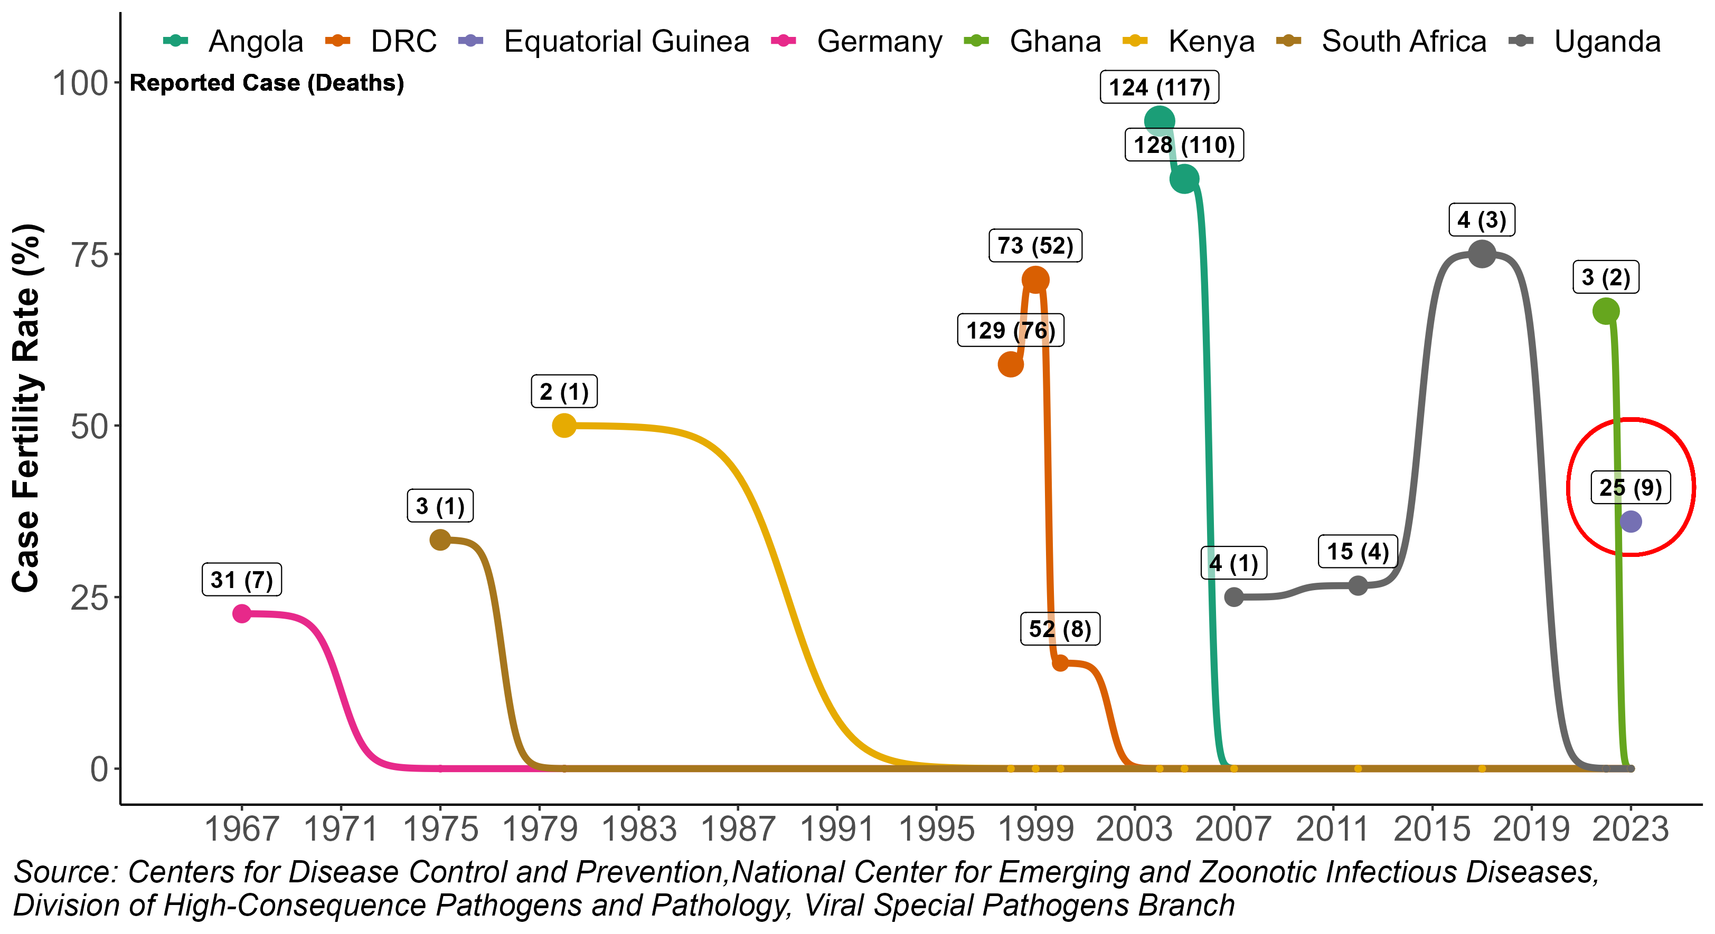
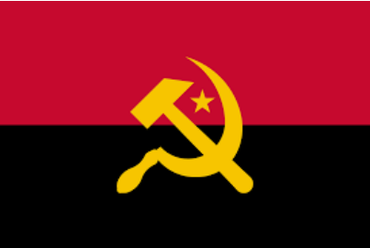






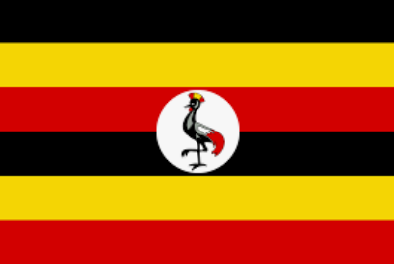
6. Marburg Virus Epidemic
Countries (year) with one reported case of Marburg virus:
Guinea (2021)
Uganda (2014)
Netherlands (2008)
USA (2008)
Russia (1990)
Kenya (1987)

